Slide 1
Customer Churn Prediction in Telecom Sector

Slide 2
Content
Understanding the problem
Exploratory Data Analysis
Prediction Algorithms
Model Evaluation metric
Additional features required
Business Strategy

Slide 3
What is churn?
In telecommunication paradigm, Churn is defined to be the activity of customers leaving the company and discarding the services offered by it, due to dissatisfaction of the services and/or due to better offering from other network providers within the affordable price tag of the customer.

Slide 4
Why is it important?
Due to the high cost of acquiring new customers, customer churn prediction has emerged as an indispensable part of telecom sectors’ strategic decision making and planning process. It is important to forecast customer churn behavior in order to retain those customers that will churn or possibly may churn
The retention of existing customers also leads to improved sales and reduced marketing cost as compared to new customers.
In order to properly manage customer churn in business, an accurate and reliable churn prediction model is needed that will study the historical patterns from existing dataset and will generate decision rules.

Slide 5
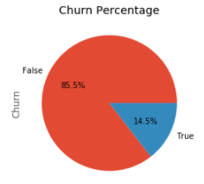
Dataset
Feature Set
unique customer Id
State
Account length
Area code
International plan
Voice mail plan
Number vmail messages
Total day minutes
Total day calls
Total day charge
Total features: 20
Total Data points: 3333
Total eve minutes
Total eve calls
Total eve charge
Total night minutes
Total night calls
Total night charge
Total international minutes
Total international calls
Total international charge
Customer service calls
Unbalanced data distribution

Slide 6
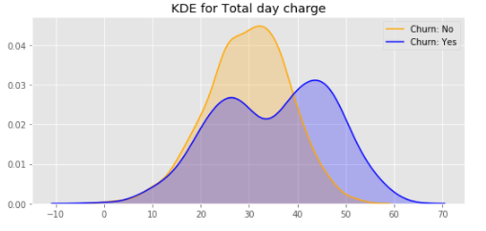
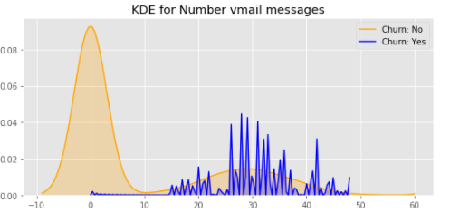
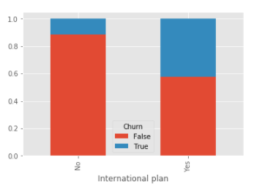
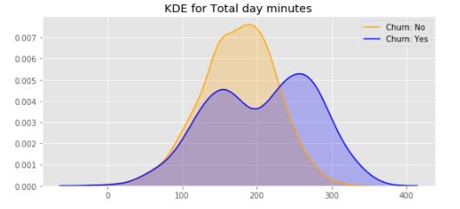
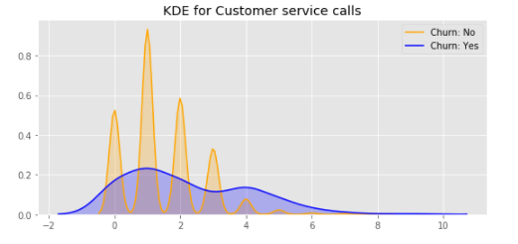
Exploratory Data Analysis
EDA was done using Kernel Density plot for continuous data and bar plot in case of categorical data.
Among the continuous variables, it was observed that there is an observable difference in the distribution of data points for “Total day charges”, “Number of vmail messages”, “Total day minutes” and number of “Customer service calls”, as shown in the figures below between customers who have churned and not churned.
Among the categorical variables, it was observed that subscribers with international plan is more like to churn than the ones without one.

Slide 7
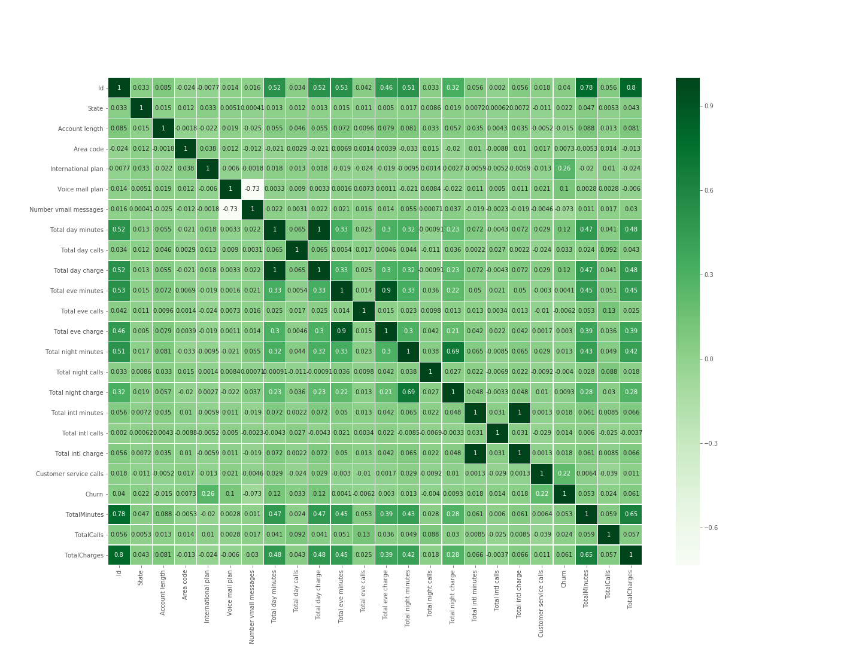
Correlation plot
A very high correlation can be observed between the following columns:
1. Total day charges and Total day minutes
2. Total eve charges and Total eve minutes
3. Total night charges and Total night minutes
4. Total intl charges and Total intl minutes
Hence one of the two was dropped.

Slide 8
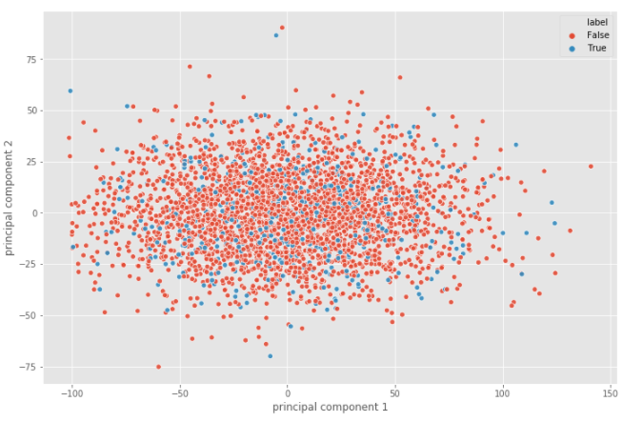
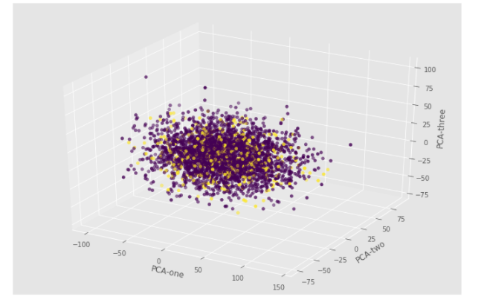
Data visualization using Dimensionality reduction techniques
The above diagrams show the 2D and 3D representation of data points using PCA. The data clearly doesn’t seem to be linearly separable in reduced dimensions based on the plots below.

Slide 9
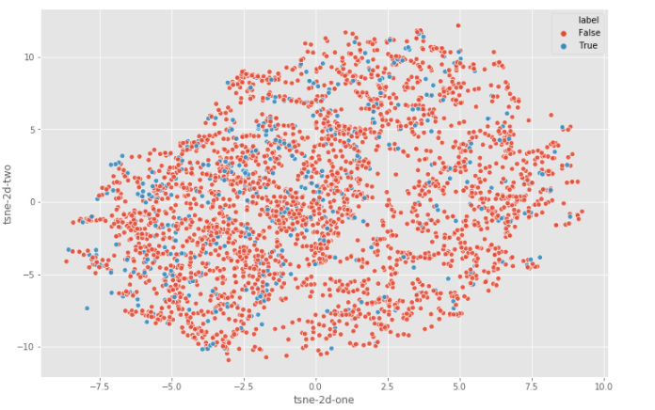
t-SNE plot

Slide 10
Methodology
The data was trained and tested using multiple algorithms namely:
Logistic Regression
Support Vector Classifier
K Nearest Neighbor
Random Forest
Ada Boost
Cross validation was used to tune the model hyper parameters.
The following metrics were tracked to measure the model performance:
Precision
Recall
F1 score
AUC ROC score
Log loss

Slide 11
Which algorithm is most appropriate for calculating churn prediction?
S. No | Model | ROC AUC score | F1 score | Precision | Recall | Log Loss
1. | Logistic Regression | 0.81 | 0.28 | 0.47 | 0.20 | 0.32
2. | Support Vector Classifier | 0.89 | 0.64 | 0.78 | 0.54 | 0.23
3. | K Nearest Neighbor | 0.72 | 0.29 | 0.70 | 0.18 | 1.84
4. | Random Forest | 0.91 | 0.85 | 0.94 | 0.77 | 0.18
5. | Ada Boost | 0.89 | 0.80 | 0.88 | 0.73 | 0.55
Clearly Random Forest has outperformed all the other models in all the 5 metric.

Slide 12
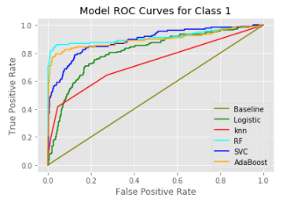
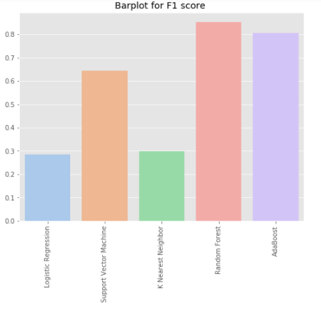
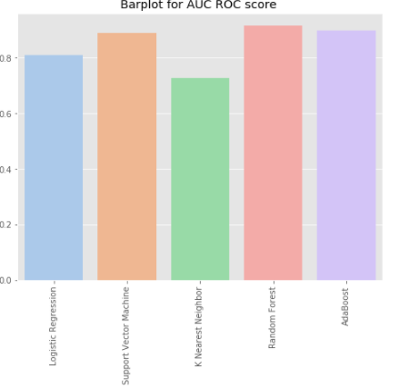
Comparison Graphical Plots of all the models across all the 5 metric.

Slide 13
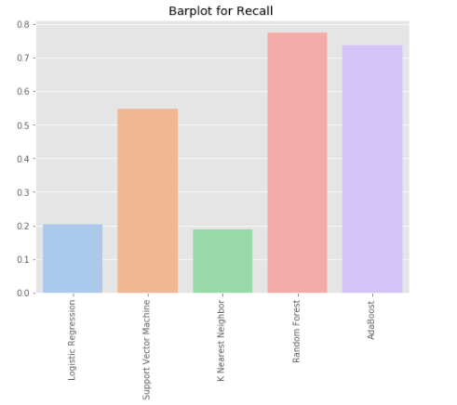
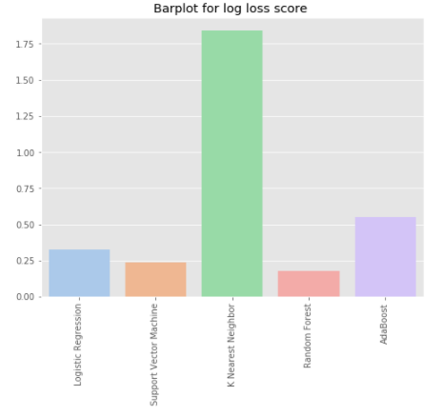
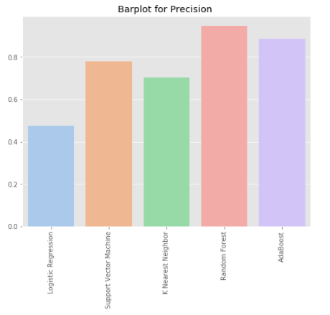
Comparison Graphical Plots of all the models across all the 5 metric.

Slide 14
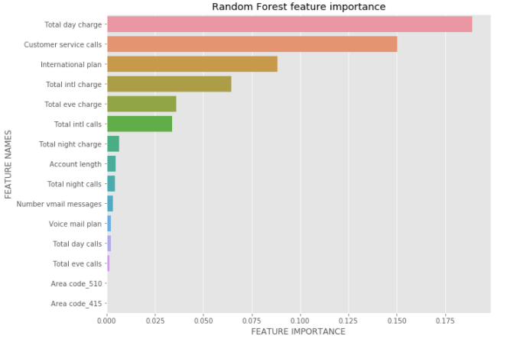
Which features are more indicative for churn prediction in telecom sector?
The Random Forest feature importance plot clearly matches with the early exploratory data analysis and the top 3 features which are indicative of churning are the following :
Total day charge
Number of Customer service calls
International plan
A similar importance has been given by other models as well.

Slide 15
Additional features that might have helped to make a better decision
Personal Information of the user.
Customer call patterns across a time series .
Number of calls made to customer who use competitor services
Number of people who have churned in the customer’s network.

Slide 16
Suggestions
Based on the Feature importance and exploratory data analysis plot
The company can maybe come up with a monthly subscription model for users who have high call duration.
Keep a close track of customers who have to call multiple time to customer service.
Introduce better International plans/connectivity.

